Slide 1
Abstract Factory
Nengbao Liu
Terence Zhao

Slide 2
Intent
“Provides an interface for creating families of related or dependent objects without specifying their concrete classes.”
- Gamma et. al (Design Patterns)

Slide 3
Motivation
Imagine we built a Sandwich Robot to work at a local hamburger restaurant.
Our SandwichBot 1.0 has been programmed to combine a sesame bun, a grilled beef patty, a slice of cheddar cheese, a piece of lettuce, and a squirt of ketchup to make a sandwich.
Let’s say that one day, SandwichBot is reassigned to a nearby hotdog stand. For SandwichBot to now make hotdogs, we would need to reprogram it to recognize a new set of ingredients. Since updating SandwichBot is costly, it should ideally be able to make sandwiches regardless of the particular ingredients available.
In a similar fashion, if our application deals with “creating families of related or dependent objects” (sandwich ingredients), we should not hard-code their creation to specific concrete classes (i.e. hamburger ingredients).

Slide 4
SandwichBot 2.0
AbstractFactory (SandwichFactory)
Declares an interface for ingredient operations that create abstract ingredient objects
ConcreteFactory (HamburgerFactory, ReubenFactory, HotdogFactory, etc.)
Implements the ingredient operations to create concrete ingredient objects
AbstractIngredient (Bread, Meat, Cheese, Vegetables, and Condiments)
Declares an interface for a type of ingredient object
ConcreteIngredient (Rye, Corned Beef, Swiss Cheese, Sauerkraut, Thousand Island dressing)
Implements the AbstractIngredient interface and defines an ingredient object to be created by the corresponding concrete sandwich factory.
Client (SandwichBot)
Uses only interfaces declared by the AbstractFactory and AbstractIngredient classes and remains unaware of the concrete classes it’s using.
Thus, SandwichBot2.0 will be able to create any number of different sandwiches since it stays independent of the specific ingredients needed and only commits to an ingredient interface.

Slide 5





UML: Sandwich Example
Client
Sesame Bun
Ketchup
Lettuce
Cheddar
HamburgerFactory
Ground Beef Patty
Sesame Bun
ConcreteIngredients
BREAD
CONDIMENTS
Rye Bread
Thousand Island
VEGETABLES
Sauerkraut
Swiss
CHEESE
Corned Beef
SandwichFactory
ReubenFactory
Rye Bread
MEAT
BREAD
AbstractIngredients
Hotdog Bun
Mustard
Relish
Cheese Sauce
HotdogFactory
Sausage
Hotdog Bun
Notes:
“Provides an interface for creating families of related or dependent objects without specifying their concrete classes.”
Consider a restaurant serves multiple kinds of sandwiches such as Hamburgers, Clubhouse, Hot dogs, etc.
In order to make the creation of a sandwich portable across different types of sandwiches, our application should not hard-code its ingredients for any specific sandwich. For example, if we started out creating hamburgers and a customer orders a Reuben,we want to be able to easily change the type of sandwiches that get created throughout the application.
We can solve this problem by defining an abstract SandwichFactory class that declares an interface for creating each basic kind of ingredient. There’s also an abstract class for each kind of ingredient, and concrete factory subclasses implement ingredients for specific sandwiches. The SandwichFactory’s interface has an operation that returns a new ingredient for each abstract ingredient class. Clients call these operations to obtain ingredient instances, but clients aren’t aware of the concrete classes they’re using. Thus clients stay independent of the prevailing ingredient creation (making bread, obtaining vegetables, etc).
There is a concrete subclass of SandwichFactory for each type of sandwich. Each subclass implements the operations to create the appropriate ingredients needed for the sandwich. For example, the Bread() operation on the HamburgerFactory instantiates and returns a Hamburger Bun, while the corresponding operation on the HotdogFactory returns a hot dog bun. Clients create sandwiches solely through the SandwichFactory interface and have no knowledge of the classes that implement ingredients for a particular sandwich. In other words, clients only have to commit to an interface defined by an abstract class, not a particular concrete class.
A SandwichFactory also enforces dependencies between the concrete ingredient classes. A Hamburger bun should be used with a Hamburger patty, and that constraint is enforced automatically as a consequence of using a HamburgerFactory.

Slide 6
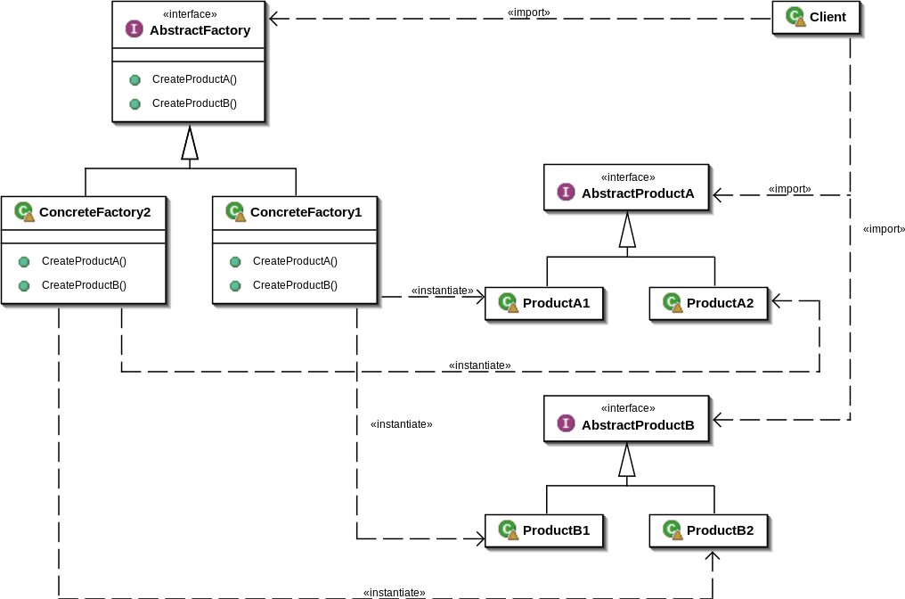
UML Diagram
The Abstract Factory pattern is useful when:
An application should be independent of how its objects are created, composed, and represented.
An application should be configured with one of multiple families of related or dependent objects.
You want to constrain an application to use a family of related objects that were designed to be used together.
You want to provide a class library of objects in which you reveal just their interfaces, not their implementations.

Slide 7
Benefits
Isolates concrete classes:
Since clients manipulate instances through their abstract interfaces, product class names are isolated in the implementation of the concrete factory.
Makes exchanging product families easy:
By simply changing the concrete factory an application uses, we can change the entire family of products all at once.
Promotes consistency among products:
Makes it easy for an application to enforce using only product objects from the same family.

Slide 8
Consequences
Supporting new kinds of products is difficult:
Since the AbstractFactory interface fixes the set of products that can be created, supporting new kinds of products requires extending the factory interface.This involves changing the AbstractFactory class and all of its subclasses.
Defining extensible factories requires a tradeoff:
A more flexible but less safe design is to add a parameter to the operations that create objects allowing the type of object created to be specified. Unfortunately, the client will not be able to differentiate the classes of the products returned or use sub-class specific operations unless it tries to downcast, which is not always feasible or safe.

Slide 9
Implementation Techniques
Factories as singletons:
Typically only one instance of a ConcreteFactory per product family is needed
Creating products via Factory Method:
We can define a factory method for each product to be overridden in a concrete factory when specifying its products, however, doing so requires a new concrete factory subclass for each product family, even if the product families are only slightly different.
Creating products via Prototype:
If many product families are possible, the concrete factory can be implemented using the Prototype pattern. The concrete factory is initialized with the prototypical instance of each product in the family and creates a new product by cloning its prototype, eliminating the need for a new concrete factory class for each new product family.

Slide 10
Code Example

